Slide 1

AIDI1012 - 23W AI ROBOTICS AND AUTOMATION
ASSIGNMENT 4
A2 GROUP MEMBERS
Shivani Bajaj(200527764)
Cheuk Ying Iu(200514612)
Fangji Chen(200520598)
Ayesha Siddiqa(200502171)
Taekeon Kim(200452564)
Shivansh Setia(200511522)
Harshal Shashikant Bhasgauri(200499159)
Hamza Kadodia(200535827)
Sahil Singal( 200506536)
Himanshu (200535823)

Slide 2
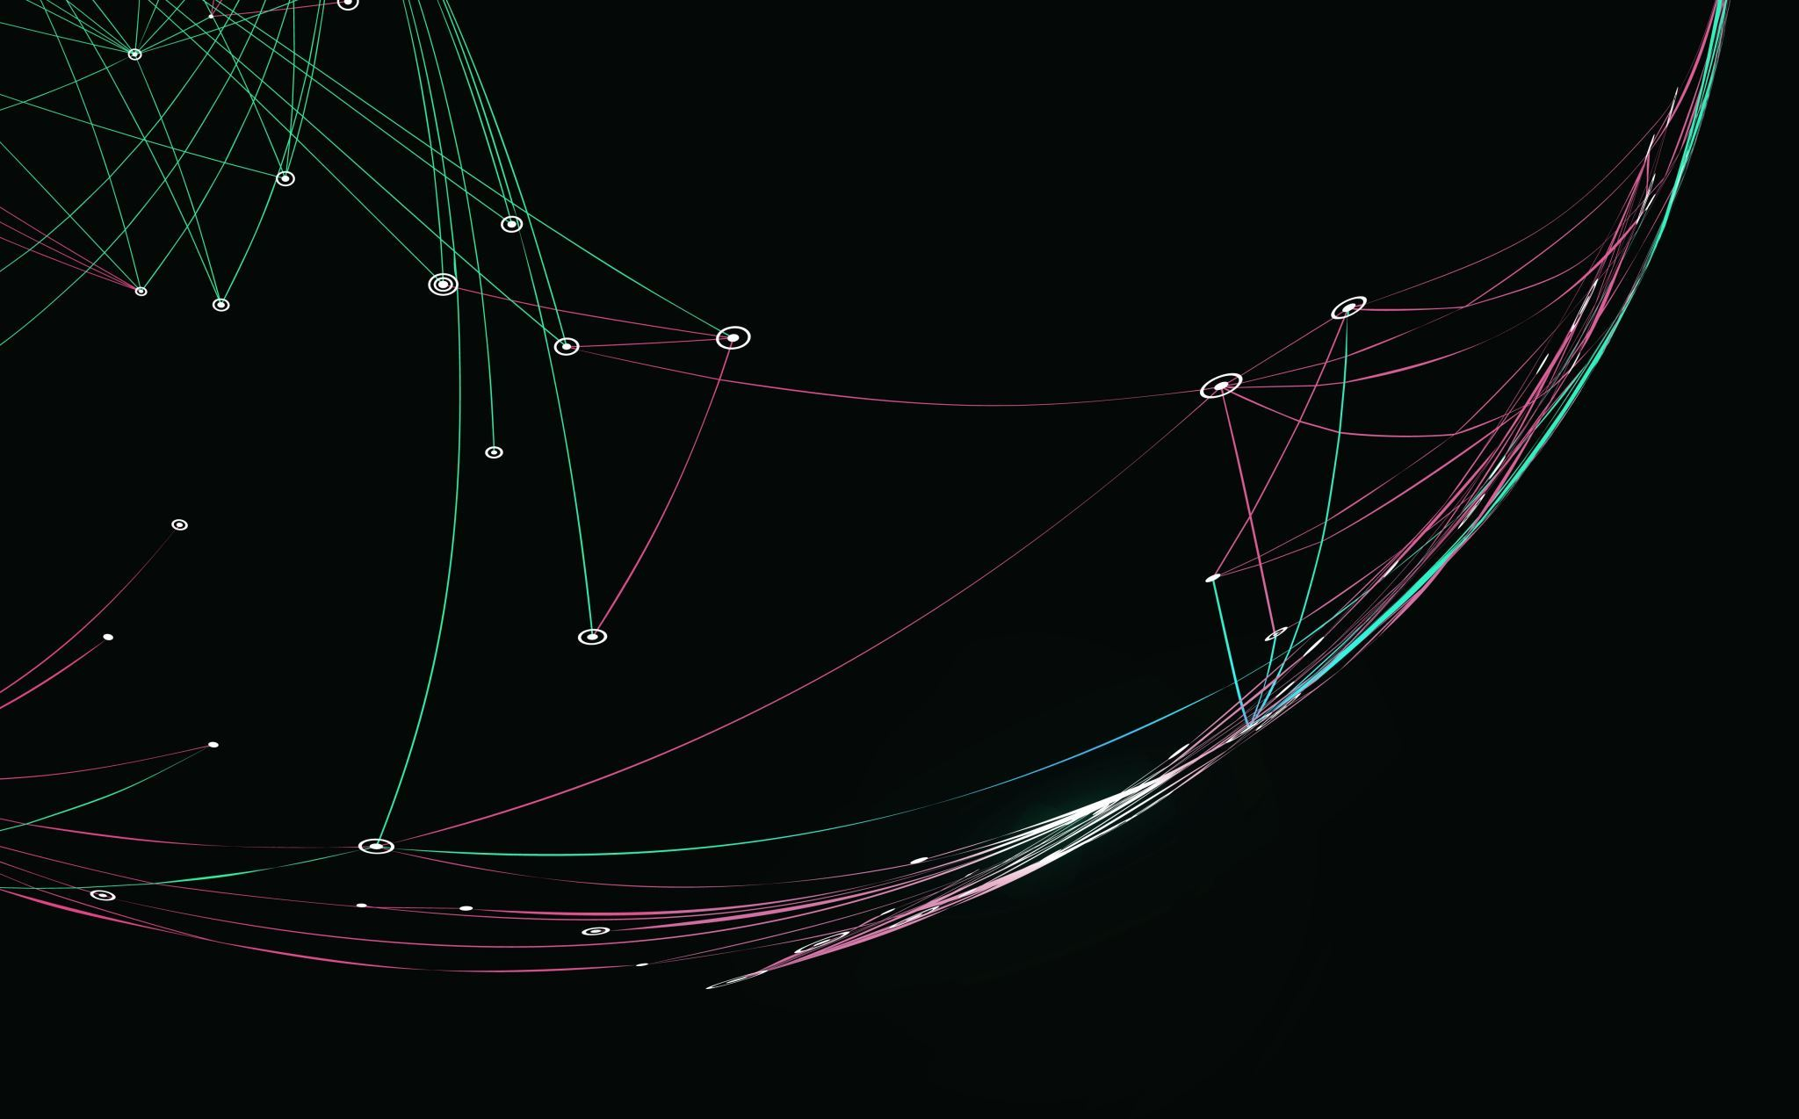
Explain about steps to Launch the container and issues to run the ROS or GAZEBO container

Slide 3
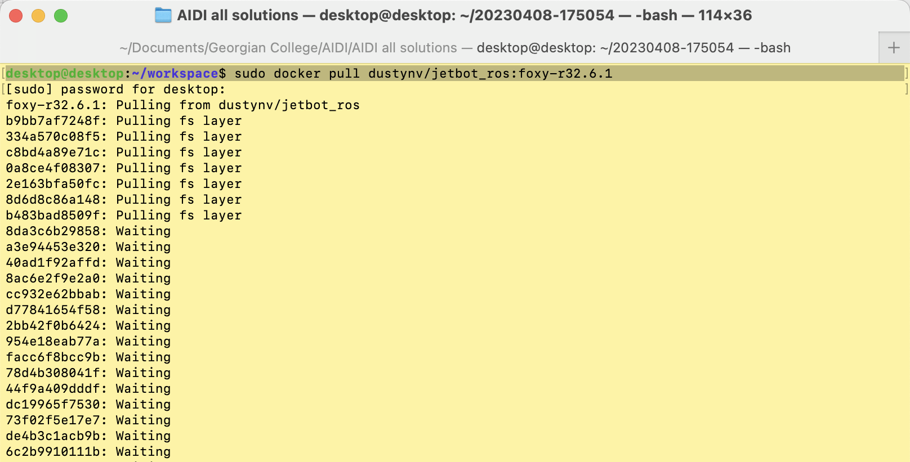
Download the container

Slide 4
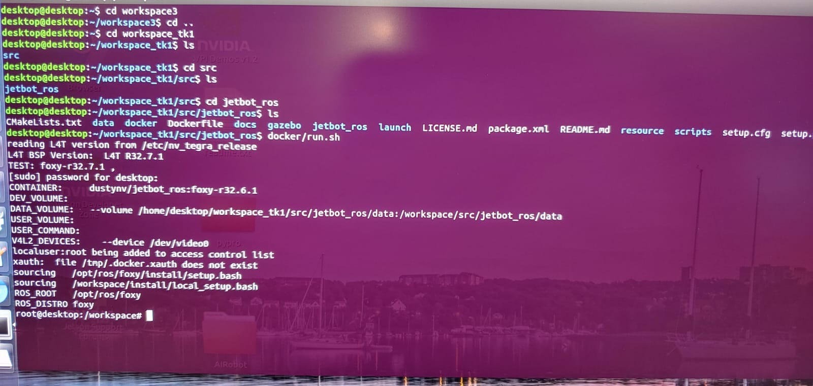
Launch the container
This is the data collection command

Slide 5
ISSUES TO RUN THE ROS OR GAZEBO CONTAINER
Running ROS (Robot Operating System) or Gazebo (a 3D robot simulation environment) inside a container can sometimes lead to issues due to the complexity of the software and the environment required for it to run. Some of the common issues faced while trying to run a ROS or Gazebo container are:
Graphics display issues: ROS and Gazebo require a graphics display to run properly. If you are running the container on a remote machine, you may need to use X11 forwarding or VNC to display the graphics.
Network issues: ROS and Gazebo rely heavily on networking for communication between nodes and simulation environments. Make sure the container is configured to use the correct network settings and that any firewalls or network security measures are properly configured.
Hardware compatibility: ROS and Gazebo rely on certain hardware components to function properly, such as graphics cards and sensors. Ensure that the container is running on a machine with compatible hardware.
Package compatibility: ROS and Gazebo rely on specific versions of packages and libraries. Make sure that the container is running the correct versions of these packages and that they are properly installed.
Resource allocation: ROS and Gazebo require a significant amount of resources, such as CPU and memory, to run smoothly. Make sure that the container is configured to allocate enough resources to run these applications effectively.
Containerization issues: Containerization itself can sometimes cause issues when running ROS or Gazebo. Make sure that the container is properly configured and that any necessary dependencies or libraries are included in the container image.

Slide 6
Explain the CNN algorithm

Slide 7
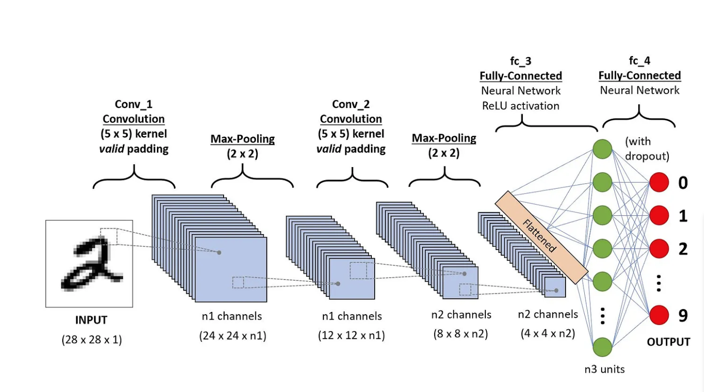
A Convolutional Neural Network (ConvNet/CNN) is a Deep Learning algorithm that can take in an input image, assign importance (learnable weights and biases) to various aspects/objects in the image, and be able to differentiate one from the other. The pre-processing required in a ConvNet is much lower as compared to other classification algorithms. While in primitive methods filters are hand-engineered, with enough training, ConvNets could learn these filters/characteristics.
The working can be explained with the following steps:
Convolutional Layer
Input image with pixels is entered into the convolutional layers
Black and white picture is interpreted as a 2D layer while color picture becomes a 3D array with RGB layers
Software selects a filter and produces a convolution movement along with the input image, moving right along the image by 1 unit
Filter multiplies values with original picture values, and all the multiplied figures are added up together to generate a single number
This process is repeated along the entire image, and a matrix smaller than the original input image is obtained
Final array is called the feature map or activation map
Convolution of an image helps perform operations such as edge detection, sharpening, and blurring by applying different filters

Slide 8
Non-linear and Pooling Layer
Non-linear layer (ReLU) follows the convolution layer where an activation function is applied to the feature maps to increase non-linearity
ReLU removes negative values and increases accuracy of the image
Pooling layer helps create several images of the same object so that the network can recognize the image, whatever its size or location
Pooling works with the image's measurements to progressively reduce the size of the input image so that objects in the image can be spotted and identified wherever they are located
Max pooling is the most common example, where the image is divided into a series of non-overlapping areas, and the maximum value in each area is identified to exclude all extra information
Fully Connected Layer
Artificial neural network is added to use CNN
This network combines different features and helps predict image classes with greater accuracy
Gradient of error function is calculated concerning the neural network's weight
Weights and feature detectors are adjusted to optimize performance, and this process is repeated repeatedly

Slide 9
Training and Optimization
The output from the fully connected layer is passed through a softmax activation function to get the probabilities for each class
The model's prediction is then compared to the actual label, and the error is calculated using a loss function such as cross-entropy loss
The goal is to minimize the error between the model's prediction and the actual label by adjusting the weights and biases in the neural network
This is done through a process called backpropagation, where the gradient of the loss function with respect to the weights and biases is calculated
The weights and biases are then updated using an optimization algorithm such as stochastic gradient descent (SGD)
The process of forward propagation (feeding data through the network) and backpropagation (calculating gradients and updating weights) is repeated for a number of epochs until the model converges and achieves good accuracy on the training set
The model is then evaluated on a separate test set to measure its generalization performance and ensure that it is not overfitting to the training data
Conclusion
Convolutional neural networks (CNNs) are powerful deep learning models for image classification
They work by using convolutional layers to extract features from the input image, non-linear layers to increase non-linearity, pooling layers to reduce the size of the feature maps, and fully connected layers to make the final prediction
Training and optimization involve minimizing the error between the model's prediction and the actual label by adjusting the weights and biases using backpropagation and an optimization algorithm
CNNs have achieved state-of-the-art results on a wide range of image classification tasks and are widely used in industry and research.

Slide 10
Data collection and training

Slide 11
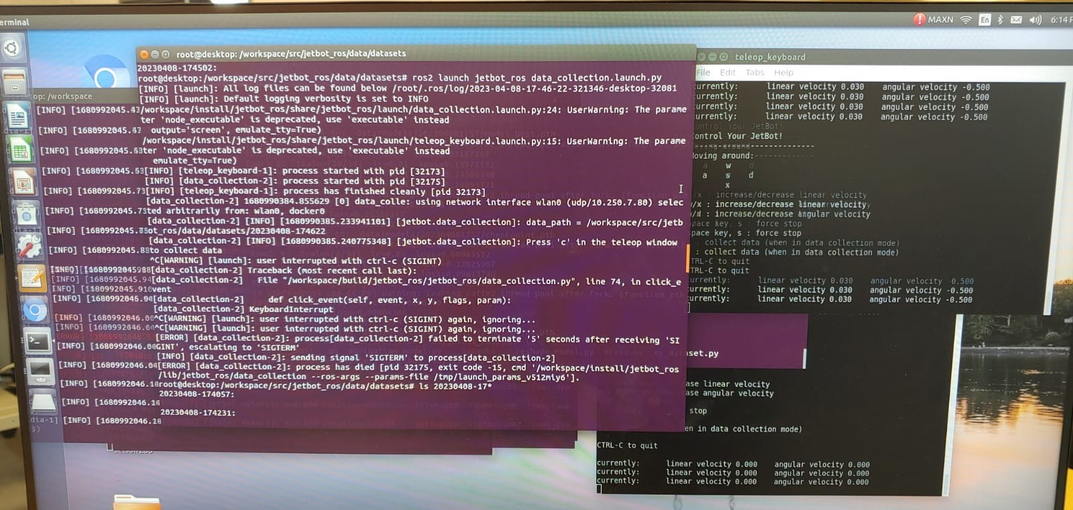
Data collecting
This is the data collection command
This is the window to catch our keyboard actions

Slide 12
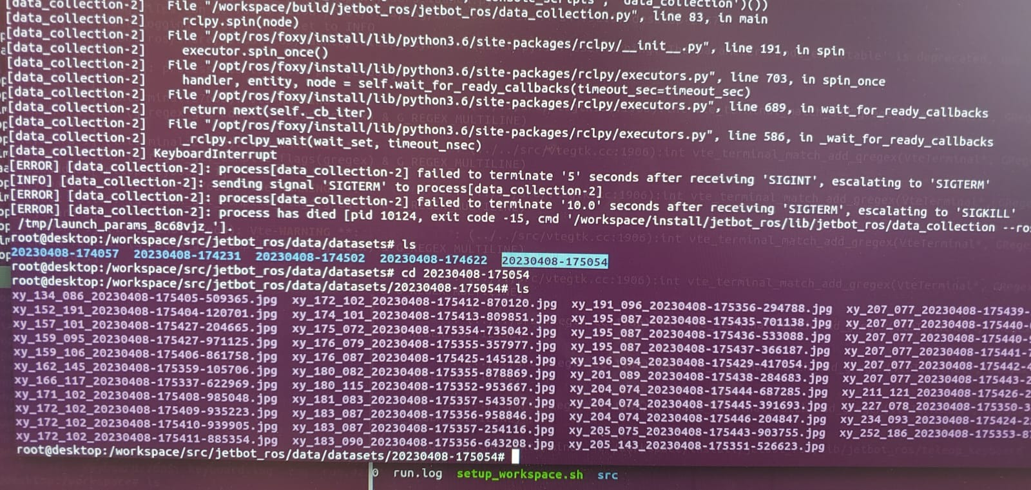
Collected training data
This is the collected training images

Slide 13
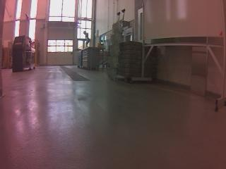
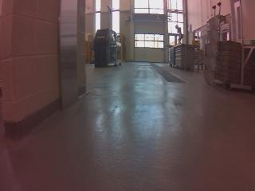
Training data examples

Slide 14
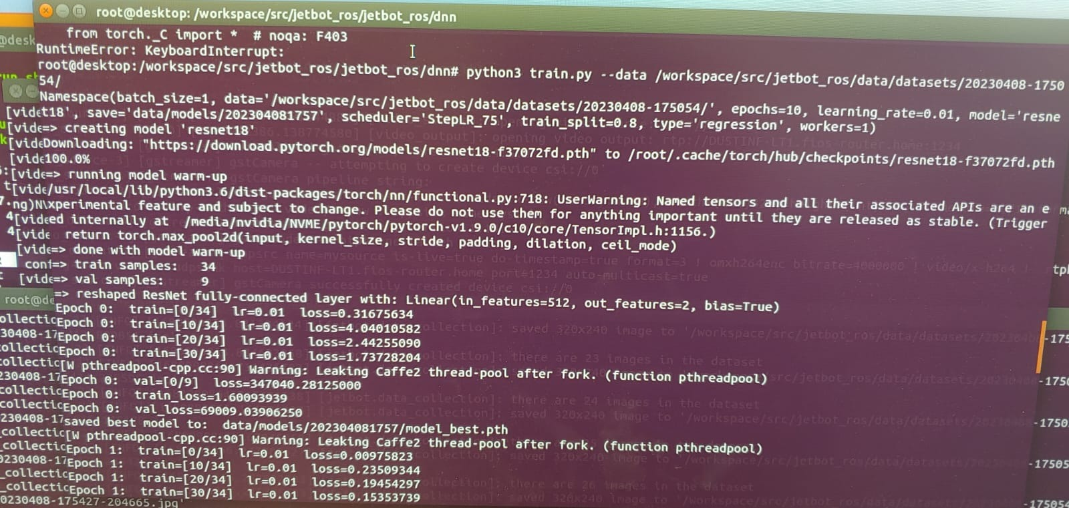
training
This is the training command

Slide 15
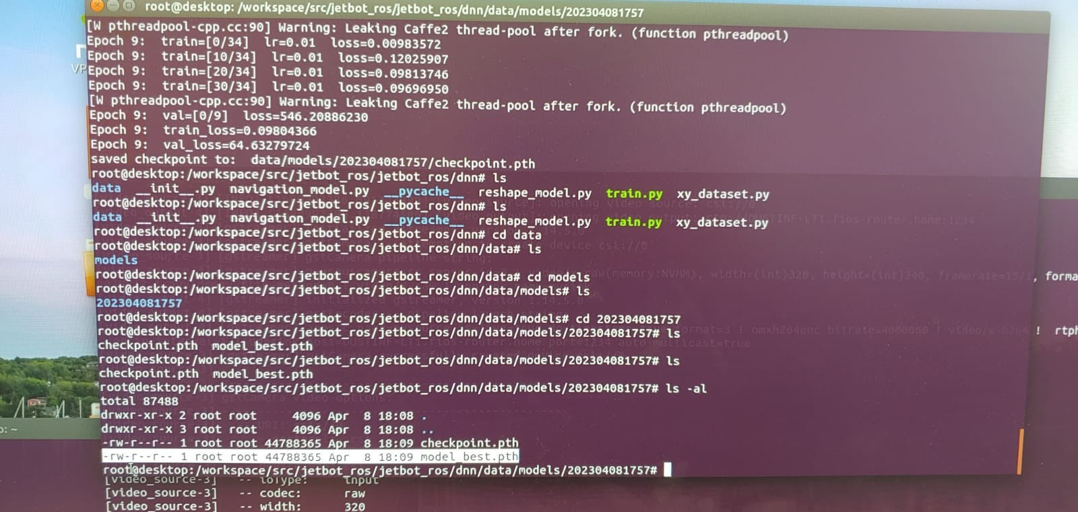
Training results
This are the training results:
Checkpoint.pth and model_best.pth

Slide 16
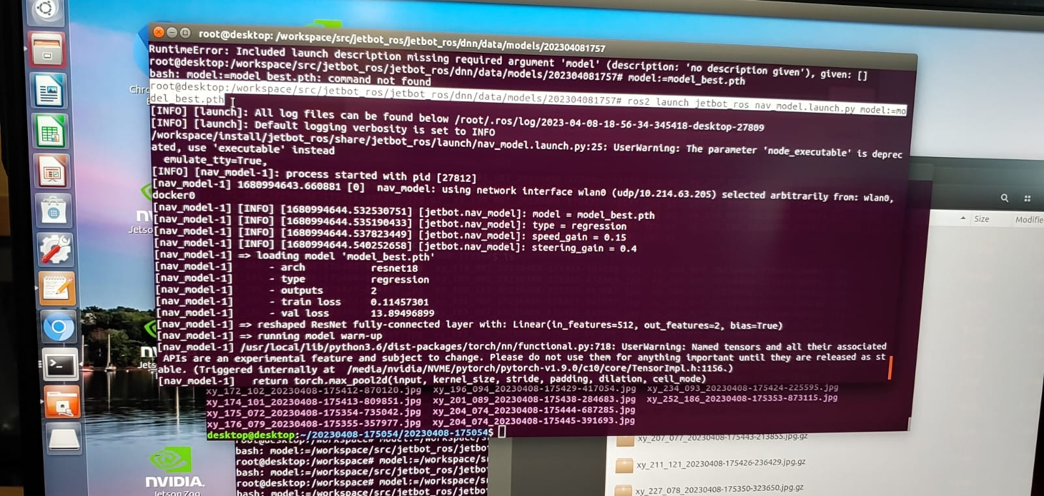
Running model with the model file
This is the model running command:
The weights file “model_best.pth” is loaded

